Slide 1


Lunch!!
For those signed up for today’s afternoon session, be back in Classroom 103 ready to go at 12:00!

Slide 2


“Simple” Plan for SUCCESS
    Be here every day!
    Follow your Syllabus (It’s your GPS)
    Ask for Help—We call it Success Lab
    Frequently remind yourself of WHY you are here

Slide 3
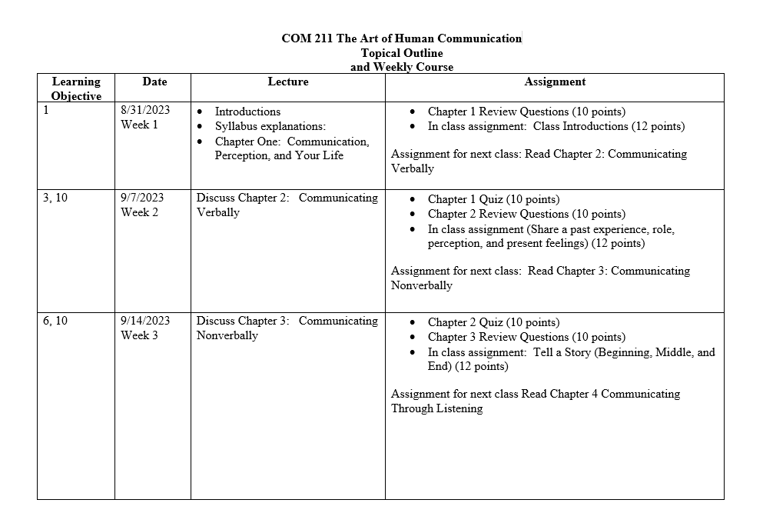
Syllabus Topical Outline

Slide 4
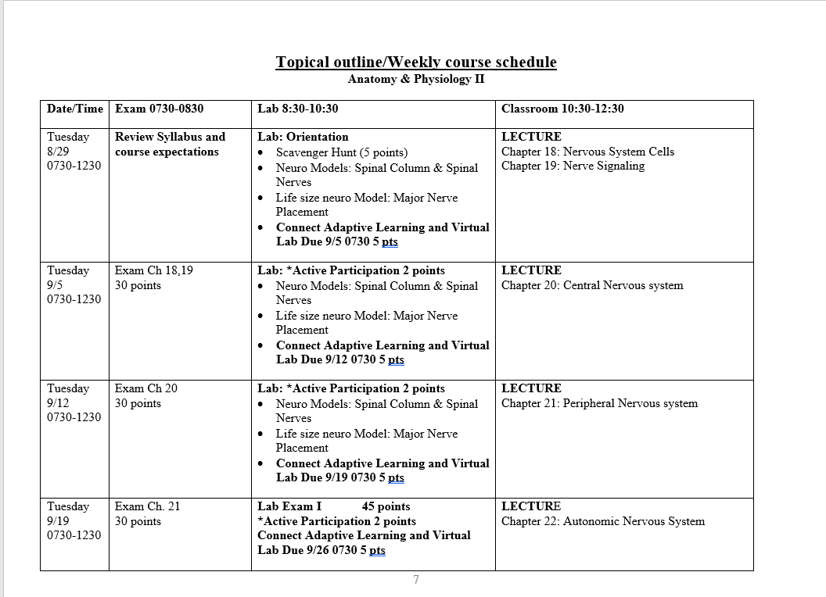
syllabus topical Outline

Slide 5
Faculty expectations for Success
Attendance
Phone usage
YOUR Commitment to academic success
Success labs
https://bolivartechnical.sharepoint.com/sites/COVIDRecordingsandAssignments/_layouts/15/stream.aspx?id=%2Fsites%2FCOVIDRecordingsandAssignments%2FShared%20Documents%2FJohnna%2FRecordings%2FMeeting%20in%20%5FJohnna%5F%2D20231214%5F144753%2DMeeting%20Recording%2Emp4&nav=eyJyZWZlcnJhbEluZm8iOnsicmVmZXJyYWxBcHAiOiJTdHJlYW1XZWJBcHAiLCJyZWZlcnJhbFZpZXciOiJTaGFyZURpYWxvZy1MaW5rIiwicmVmZXJyYWxBcHBQbGF0Zm9ybSI6IldlYiIsInJlZmVycmFsTW9kZSI6InZpZXcifX0&ga=1&referrer=StreamWebApp%2EWeb&referrerScenario=AddressBarCopied%2Eview
Johnna Mortensen

Slide 6




Learning Styles
Visual Sees to Learn Visualizes Likes Pictures | Tactile Moves to Learn Likes Hands On Does to Remember | Auditory Hears to Learn Likes Listening Likes Discussion | Read/Write Studies to Learn Likes to Read Likes to Take Notes
Learning Styles Inventory

Slide 7

Success strategies

Slide 8
Keys to effective learning
  Improve your memory
  Get regular physical exercise
  Get enough sleep!
  Eliminate distractions to focus on what you’re learning
  Organize the information you are studying to make it easier to remember
  Use visual aids like photographs, graphs or charts
  Read the information you are studying out loud
  Keep learning new things
    Use it or lose it
  Teach what you are learning
    Teach each other new information in your study group

Slide 9
Keys to effective learning
Build on previous learning
  Med Surg I and Med Surg II
Gain practical experience
  Sim Lab and Clinicals
Take frequent breaks
  Instead of a cram session, try a brief focused session, then take a break (15-20 minutes)
  The process of returning for brief sessions over a long period of time is one of the most effective learning techniques
Take tests
  Make up a practice exam-based material from several chapters, take the practice exam in test like conditions, then refocus on the material you missed
Stop multitasking
  Research has indicated that multitasking, particularly with different media sources, can have a detrimental impact on learning and academic performance

Slide 10
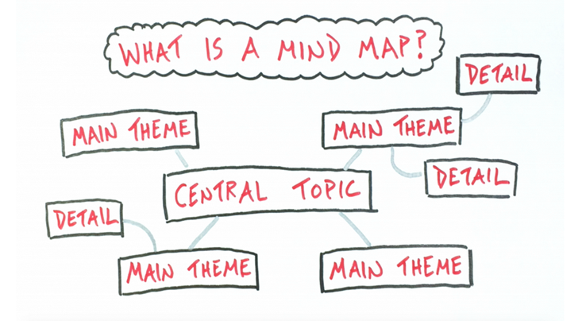
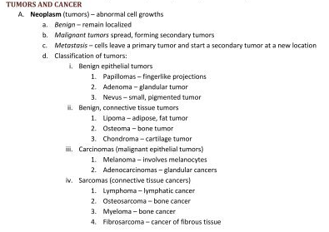
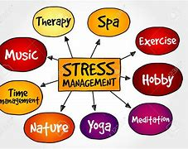
Keys to Effective Learning—Note taking styles
Outline note-taking method
Mind Mapping or Concept Mapping

Slide 11
Keys to Effective Learning—Review your materials
Review before class:
Review notes from previous session
Review your reading assignment
Make sure you have pens, paper, textbook, handouts
Always write the date at the top of your paper notes
Leave spaces between the lines so you can add information later
Review after class
  Review notes along with book
  Create your own examples
  Discuss and compare notes with classmates/peers
  Practice skills you wish to develop
  Ask instructor for clarification
  Rewrite your notes (using method that suits your learning style)
Keep in mind that reviewing your notes three times significantly increases your brain’s ability to retain the information

Slide 12
test taking strategies

Slide 13
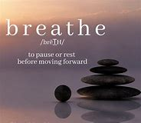
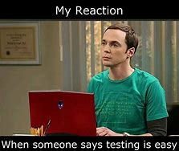

Before the test
DURING THE TEST
  Schedule daily, weekly and major
  review sessions
  Create study checklists
  Create mind map summary sheet
  Make flash cards
  Take a practice test
  Get plenty of rest and proper nutrition!
BREATHE
Read the questions carefully
Multiple Choice (Read all answers)
Get to class a few minutes early

Slide 14
After the test
Evaluate
Evaluate your performance after every test
Take
Take note of where you struggle, short answer, True/False, or multiple choice
Meet
Meet with instructor to discuss low scores to see how you can improve

Slide 15



Test taking question strategies
Read the question carefully
Read through all the answers before choosing one
Eliminate incorrect choices
Watch for combinations—”all the above” or “none of the above”
Read the question carefully
Look for absolute or limiting words (examples: always, every, all, no, never, none, guaranteed, only)
If any part of the answer is false, the whole thing is false

Slide 16

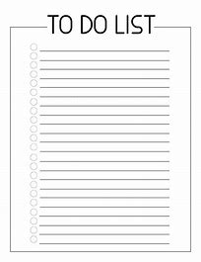
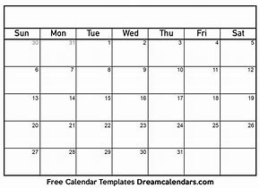
Time management strategies
Identify time wasters and set goals
Plan ahead by creating a To Do List
Prioritize your tasks
Check lists are your friend!!
Use a Calendar for Planning

Slide 17

Time management strategies
Set routines are helpful to plan study time
When is your home quietest? Use that time to get in the habit of using that time to study or read
Use
Use breaks wisely
Time between work, classes and activities can be used to complete tasks
Work in short intervals and take short, regular, timed breaks. For example, use a timer to work in 25 minutes sprints, broken up by 5 minutes breaks
Establish routines
Establish

Slide 18
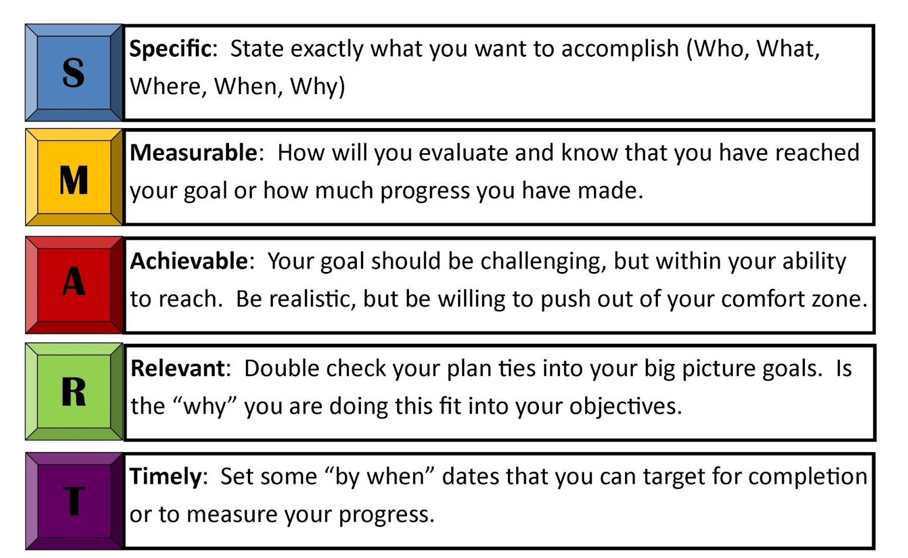

Set Smart Goals
SMART Goal:
By the end of this semester, I will achieve an overall grade average of 3.0 or higher by consistently attending all classes, dedicating a minimum of 2 hours each day to focused studying and assignments, actively participating in class discussions at least twice a week, seeking clarification from instructors or peers whenever I encounter challenges, and utilizing effective time management techniques to balance my academic commitments and family life.

Slide 19
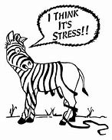

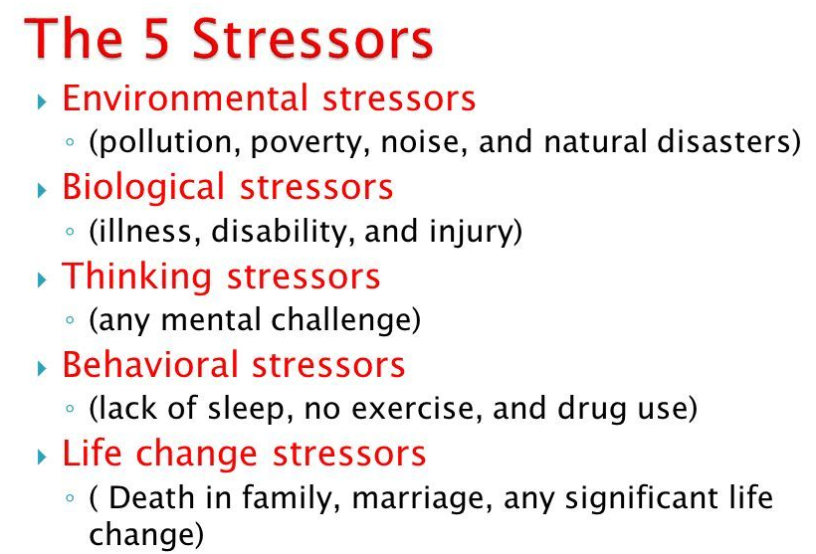
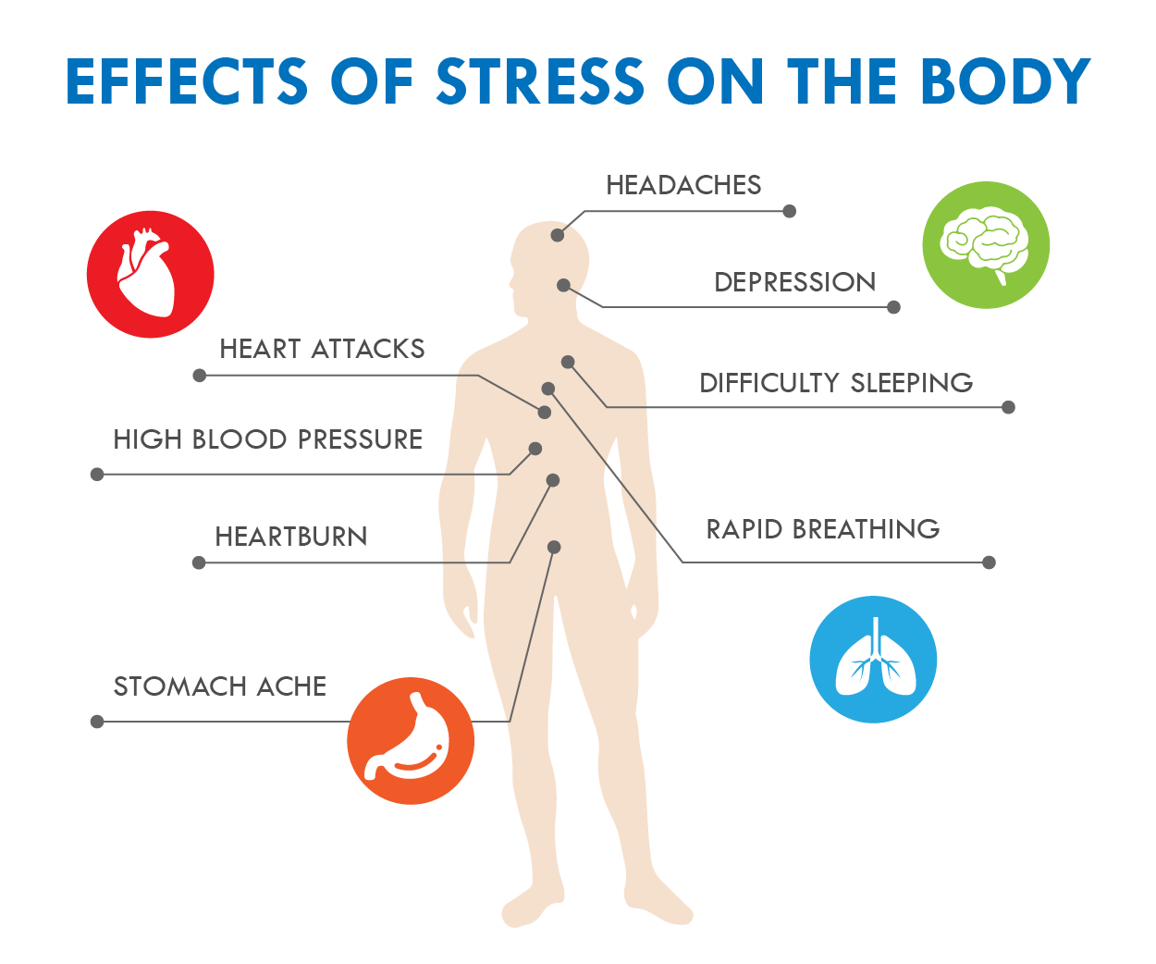
Identifying Stress
What does stress look like?
How it affects ability to focus, academics?

Slide 20
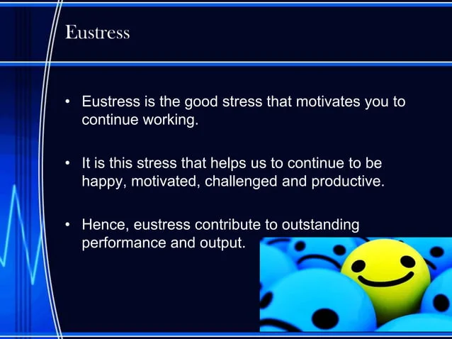
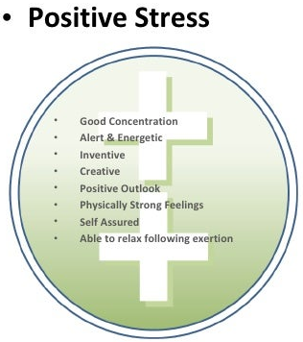
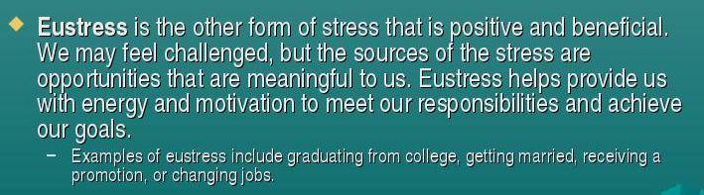
Identifying Stress—Positive

Slide 21
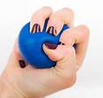



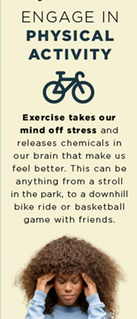
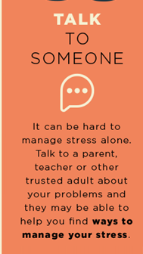
Coping With stress
Coping mechanisms
Coping mechanisms
5 Ways to Cope with Stress

Slide 22

Student/faculty communication & relationship
Instructors are vital to your education and development as a healthcare professional
  Start building this relationship at the beginning of the semester
  Address your instructor by their proper title (Mr., Mrs., Ms.)
  Be respectful of their time, utilize office hours and schedule appointments / Success Labs
    DO NOT go directly to instructor’s office, always check in at front desk (may have another student in office, etc.)
    Just as you have outside obligations/family, they do as well – be respectful of evenings/weekends
  During scheduled time with instructors, be prepared with specific questions or discussion topics
  Demonstrate to them your interest in the course and your desire to do well

Slide 23

Emailing your instructor
Our goal is to prepare you for a profession in healthcare, part of
that education is learning professionalism
When emailing instructors
  Instructor’s email will be first initial, last name@bolivarcollege.edu
  Use your BTC account (always)
  Know your instructor’s preferences and policies regarding email
  Format your email properly (idk when assignment due, can u help? – brb, went 2 lunch - not professional)
  Be clear and specific, after you write it, reread it a couple of times
  When in doubt, always use formal language that is respectful
  Check your email everyday

Slide 24
Congratulations on your decision to become a nurse !
For any additional questions please contact:
NANCY BRANNON
NBRANNON@bolivarcollege.edu
417-777-5062

